Slide 1
Image Classification Using CIFAR – 10 dataset and Convolution Neural Networks
Team Members:
1.) Sai Teja Panasa - 700745668
2.) Pravalika Medasani - 700744503
3.) Sai Yashwanth Reddy Kontham - 700744498
4.) Kyossh Kanna Kannan - 700760191

Slide 2
Contributions:
Sai Teja Panasa:
Exploring, Planning, developing a feasible code, error solving, execution, Documenting
Pravalika Medasani:
Exploring, Managing Communication and Collaboration between group members, Error solving in code, Documenting the project report, powerpoint presentation
Sai Yashwanth Reddy Kontham:
Extensive Research, Papers Findings, Gathering data, Optimized the model for better performance and conducted number of evaluations.
Kyossh Kanna Kannan:
Extensive Research, Papers Findings, Gathering data, Optimized the model for better performance and conducted number of evaluations.

Slide 3
Motivation:
AI and Machine Learning Advancements
Industry Applications
Digital Era Data Challenges
Technological Complexities
Deep Learning Opportunities
Innovation Potential
Contribution to AI Research
Standard for Benchmarking
Educational Tool:
Performance Evaluation:
Methodology Development:
Data Variety and Complexity:

Slide 4
Objective:
Develop and Evaluate CNN Models: To develop and evaluate various convolutional neural network (CNN) models using the CIFAR-10 dataset for image classification.
Achieve High Accuracy: Aim to achieve high classification accuracy in categorizing images into one of the ten available categories in CIFAR-10.
Optimize Model Parameters: Experiment with different model parameters and configurations to find the most effective setup for image classification.
Explore Deep Learning Techniques: Utilize and explore various deep learning techniques and architectures to improve the performance of the models.
Contribute to Image Classification Research: To contribute to the broader field of image classification by demonstrating effective techniques and methodologies using a well-known dataset.
Practical Application of Theoretical Knowledge: Apply theoretical knowledge of neural networks and deep learning in a practical, real-world problem of image classification.

Slide 5
Related Work:
Title: "CIFAR-10 Image Classification with Deep Convolutional Neural Networks" by Alex Krizhevsky, Vinod Nair, and Geoffrey Hinton
Methodology: This paper proposes a deep convolutional neural network (CNN) architecture for image classification on the CIFAR-10 dataset. The CNN consists of five convolutional layers, three pooling layers, and two fully connected layers. The authors train the CNN on a dataset of 50,000 training images and 10,000 testing images.
Results: The CNN achieves a test error rate of 7.35%, which is significantly better.

Slide 6
Title: "All-CNN Models for Classification on CIFAR-10" by Jonathan Long, Evan Shelhammer, and Trevor Darrell
Methodology: This paper proposes a CNN architecture that consists only of convolutional layers and pooling layers. The authors train the CNN on a dataset of 50,000 training images and 10,000 testing images.
Results: The CNN achieves a test error rate of 6.99%, which is better than the results of the previous paper.
Title: "Network in Network" by Min Lin, Qiang Chen, and Shuicheng Yan
Methodology: This paper proposes a CNN architecture that incorporates the idea of "network in network" (NIN). NIN is a technique for stacking multiple small CNNs together. The authors train the NIN on a dataset of 50,000 training images and 10,000 testing images.
Results: The NIN achieves a test error rate of 5.75%, which is the best result reported so far on the CIFAR-10 dataset.

Slide 7
Problem Statement:
The primary problem your project addresses is the development of an effective and efficient Convolutional Neural Network (CNN) model for accurate image classification using the CIFAR-10 dataset.
This involves categorizing images into one of the ten distinct classes represented in the dataset, each containing various objects.
Significance of the Problem:
Image classification is a challenging problem because it requires the algorithm to learn to identify objects from a wide variety of images.
The CIFAR-10 dataset is a popular benchmark for image classification because it is relatively small and easy to train on, but it is still challenging enough to be a good test of an algorithm's performance.
Challenges:
High Dimensionality: Managing the computational intensity due to the high dimensionality of images.
Variability and Overfitting: Training a model that generalizes well across diverse images within classes and similar images across different classes.
Model Performance Optimization: Achieving a balance between model complexity and efficiency.
Data Augmentation and Preprocessing: Choosing appropriate techniques to improve model performance while maintaining image integrity.

Slide 8
Problem Solution:
Overview of CIFAR – 10 dataset:
The CIFAR-10 dataset is a collection of 60,000 32x32 color images in 10 different classes, with 6000 images per class. There are 50,000 training images and 10,000 test images. The dataset is divided into five training batches and one test batch, each with 10,000 images.
The CIFAR-10 dataset consists of the following 10 classes:
Airplane, Automobile, Bird, Cat, Deer, Dog, Frog, Horse, Ship, Truck, Images
The images in the CIFAR-10 dataset are all 32x32 pixels in size and are in RGB color format. The images are normalized to have a mean value of 0 and a standard deviation of 1.
Data Distribution: The training and test sets are balanced, with each class having 5000 training images and 1000 test images.
Origin: The CIFAR-10 dataset was created by the Canadian Institute for Advanced Research (CIFAR) and is based on the Tiny Images dataset.
Uses: The CIFAR-10 dataset is a popular benchmark for image classification algorithms. It is used to evaluate the performance of different algorithms and to compare new algorithms to the state-of-the-art.

Slide 9
Convolutional Neural Networks (CNNs):
A type of artificial neural network (ANN) well-suited for analyzing grid-like data, such as images
Inspired by the visual cortex of the human brain, responsible for processing visual information
Working:
Process data using a series of convolutional layers
Each convolutional layer applies a filter to the input data, producing a feature map
Feature map highlights important features of the input data, such as edges, lines, and shapes
Pooling layers:
Reduce the dimensionality of the data by summarizing the information in a small region of the feature map
Help reduce computational cost of training the CNN and prevent overfitting
Applications of CNNs:
Image classification: High accuracy, even for noisy or partially occluded images
Object detection: Objects in images, even small or hard to see
Image segmentation: Images into different regions, such as foreground and background
Natural language processing (NLP): Process text data, such as for sentiment analysis and machine translation

Slide 10
Advantages of CNNs:
Translation invariance: Recognize objects regardless of their position in the image
Scale invariance: Recognize objects regardless of their size in the image
Reduced number of parameters: Easier to train and less prone to overfitting
Disadvantages of CNNs:
Computational complexity: Expensive to train, especially for large-scale datasets
Data requirements: Large amount of training data for good performance
Limited interpretability: Difficult to interpret, making it hard to understand decision-making

Slide 11
Parameters Used:
Number of convolution layers: Determines the depth of the CNN and the complexity of the features it can extract. More layers generally lead to more complex feature extraction but can increase computational cost.
Number of pooling layers: Reduces the dimensionality of the feature maps and controls the amount of spatial information retained. More layers reduce spatial information but help prevent overfitting.
Number of dropout layers: Randomly drops a certain percentage of neurons during training, preventing co-adaptation and improving generalization. More layers can improve performance but increase training time.
Activation function: Introduces non-linearity into the network, allowing it to learn complex patterns. Common choices include sigmoid, tanh, and ReLU.
Optimizer: Updates the weights and biases of the network to minimize the loss function. Common optimizers include gradient descent, SGD, and Adam.
Kernel Initialization: Sets the initial values of the weights in the convolutional layers. Proper initialization methods can improve the training process and convergence.
Epochs: The number of times the entire training dataset is passed through the network during training. More epochs generally lead to better performance but can increase training time.
Batch-size: The number of training examples processed simultaneously during training. Larger batch sizes improve computational efficiency but can affect gradient descent.

Slide 12
Model 1:
Parameters Used :
Number of convolution layers: 5
Number of pooling layers: 1
Number of dropout layers: 1
Activation Function: tanh
Optimizer: Adamax
Kernel Initialization:
random-normal
Epochs-50
Batch-size : 32
Accuracy: 74.12%
Validation Accuracy: 65.57%
Loss:0.7288
Validation Loss: 1.0423

Slide 13
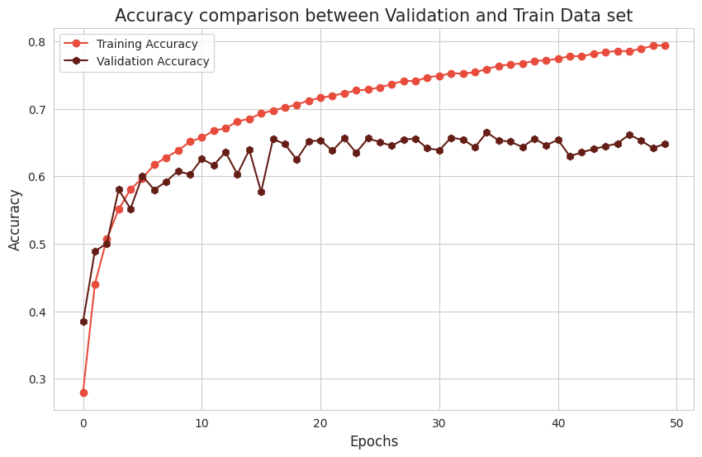

Slide 14
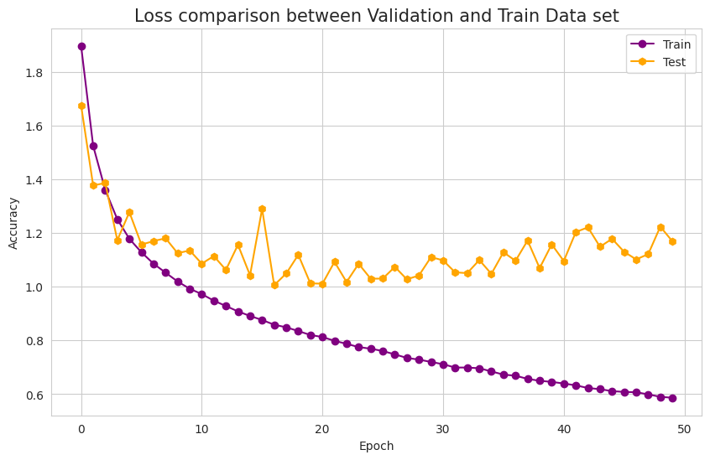

Slide 15
Model 2:
Parameters Used :
Number of convolution layers: 8
Number of pooling layers: 1
Number of dropout layers: 1
Activation Function: ReLu
Optimizer: RMSProp
Kernel Initialization:
random_normal
Epochs-100
Batch-size : 500
Accuracy: 94.60%
Validation Accuracy: 72.19%
Loss:0.1524
Validation Loss:1.3285

Slide 16
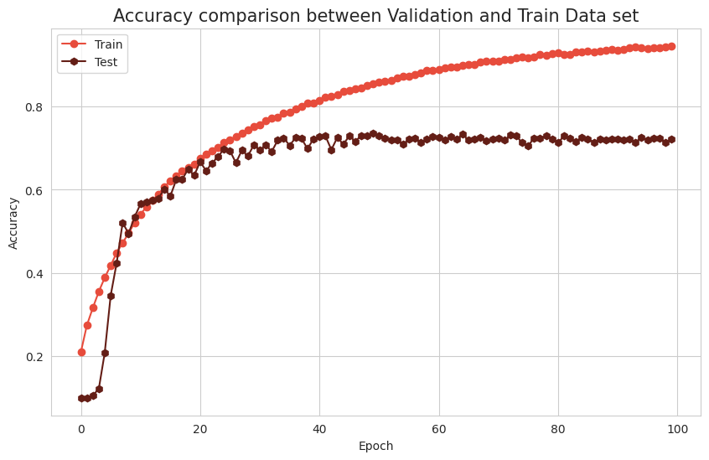

Slide 17
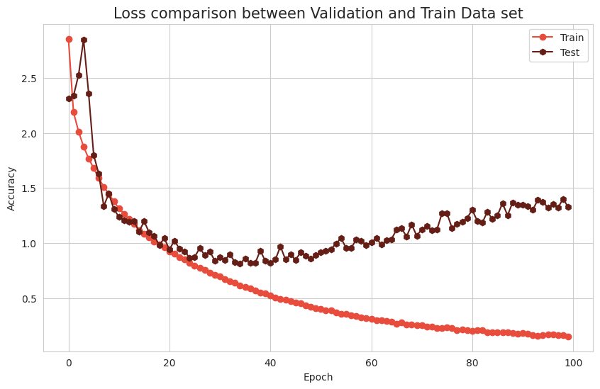

Slide 18
Model 3:
Parameters Used :
Number of convolution layers: 7
Number of pooling layers: 3
Number of dropout layers: 3
Activation Function: relu
Optimizer: Adam
Kernel Initialization:
glorot_uniform
Epochs-200
Batch-size : 100
Accuracy: 95.99%
Val_Acc : 59.63%
Loss: 0.1113
Validation-Loss:2.9100

Slide 19
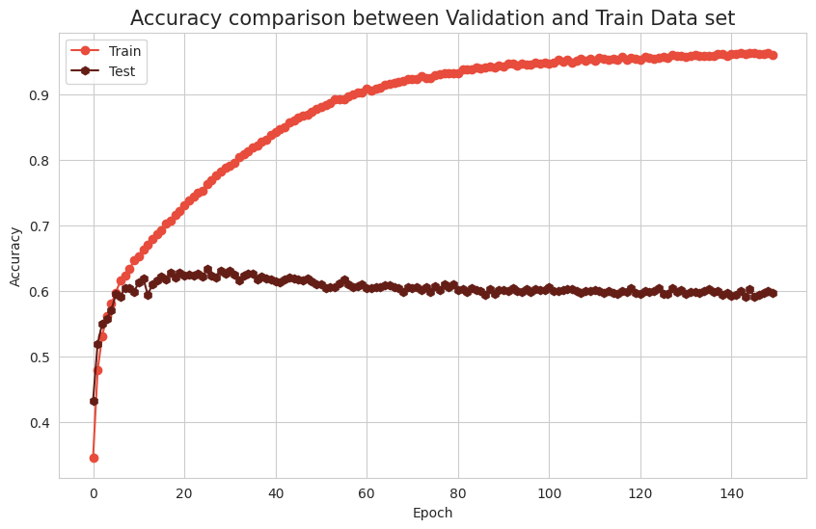

Slide 20
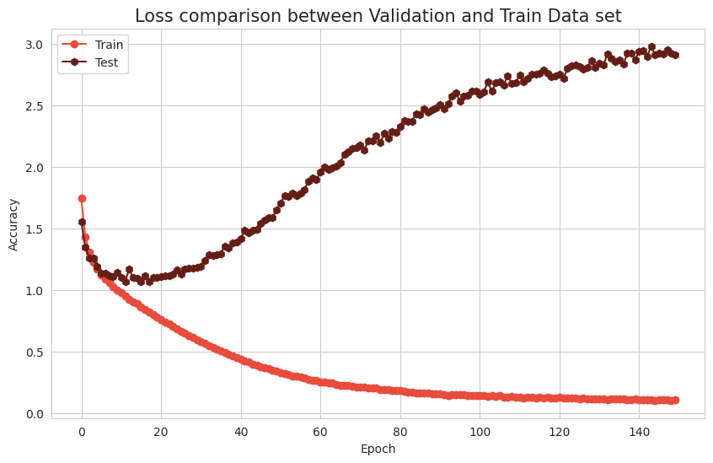

Slide 21
Model 4:
Parameters Used :
Number of convolution layers: 7
Number of pooling layers: 3
Number of dropout layers: 3
Activation Function: reLu
Optimizer: Adamax
Kernel Initialization:
uniform
Epochs-50
Batch-size : 500
Accuracy: 82.15%
Validation Accuracy: 77.03%
Loss:0.5056
Validation Loss:0.6998

Slide 22
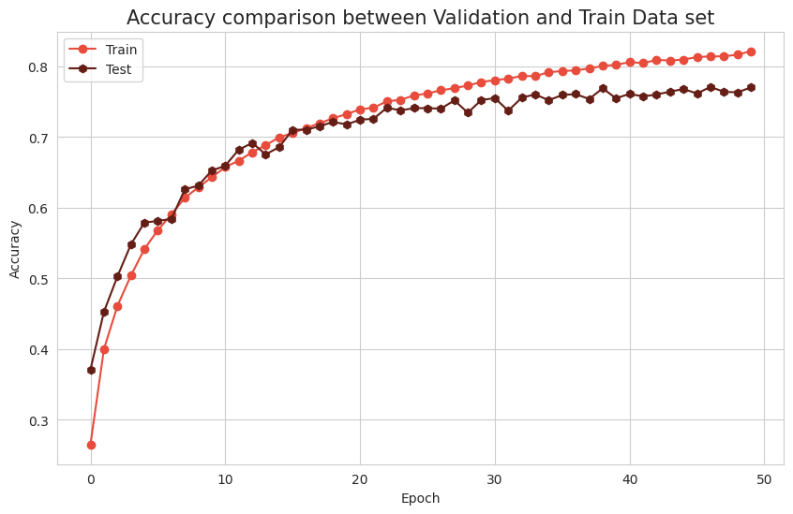

Slide 23
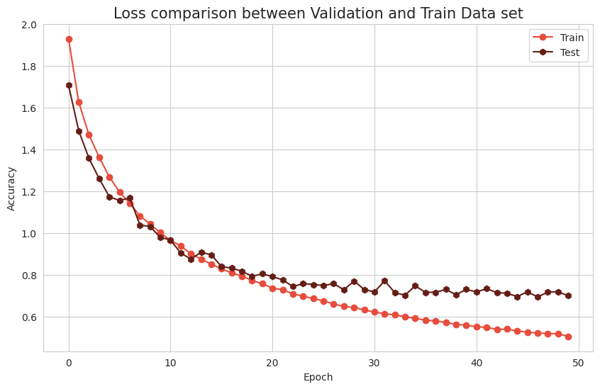

Slide 24
Model 5:
Number of convolution layers: 10
Number of pooling layers: 3
Number of dropout layers: 3
Activation Function: relu
Optimizer: Adam
Kernel Initialization:
glorot_uniform
Epochs-50
Batch-size : 100
Accuracy: 81.63%
Val_Acc : 76.59%
Loss: 0.5211
Validation-Loss:0.6746

Slide 25
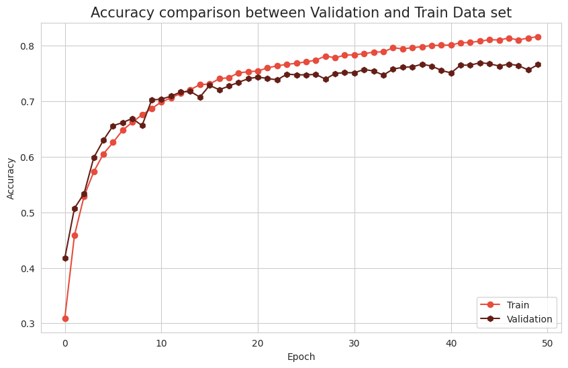

Slide 26
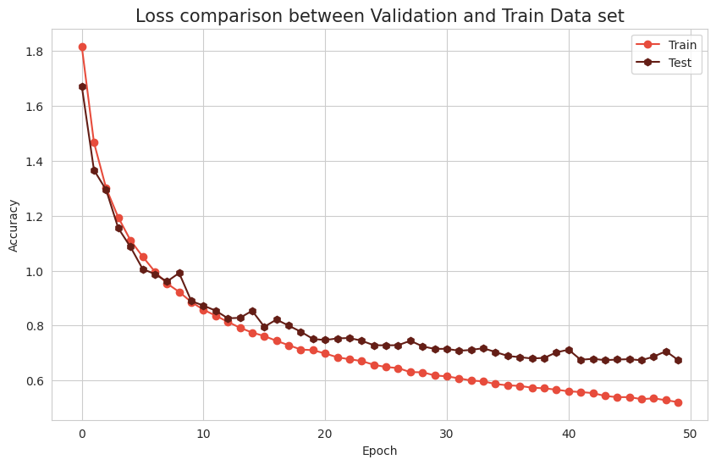

Slide 27
Model | Accuracy | Validation Accuracy | Loss | Validation Loss
Model 1 | 74.12% | 65.57% | 0.7288 | 1.0423
Model 2 | 94.60% | 72.19% | 0.1524 | 1.3285
Model 3 | 95.99% | 59.63% | 0.1113 | 2.9100
Model 4 | 82.15% | 77.03% | 0.5056 | 0.6998
Model 5 | 81.63% | 76.59% | 0.5211 | 0.6746

Slide 28
References:
1.) Simonyan, K., & Zisserman, A. (2014). Very Deep Convolutional Networks for Large-Scale Image Recognition. arXiv preprint arXiv:1409.1556.
2.) He, K., Zhang, X., Ren, S., & Sun, J. (2016). Deep Residual Learning for Image Recognition. In Proceedings of the IEEE Conference on Computer Vision and Pattern Recognition (CVPR), 770-778.
3.) Cortes, C., & Vapnik, V. (1995). Support-vector networks. Machine Learning, 20(3), 273-297.
4.) Lowe, D. G. (1999). Object recognition from local scale-invariant features. In Proceedings of the Seventh IEEE International Conference on Computer Vision (ICCV), 1150-1157.
5.) Breiman, L. (2001). Random forests. Machine Learning, 45(1), 5-32.
6.) Huang, G., Liu, Z., Van Der Maaten, L., & Weinberger, K. Q. (2017). Densely connected convolutional networks. In Proceedings of the IEEE Conference on Computer Vision and Pattern Recognition (CVPR), 4700-4708.
7.) Zhang, H., Goodfellow, I., Metaxas, D., & Odena, A. (2020). Self-Gated Networks with Attention Mechanism for Image Classification. arXiv preprint arXiv:2001.01692.
8.) Lecun, Y., Bottou, L., Bengio, Y., & Haffner, P. (1998). Gradient-based learning applied to document recognition. Proceedings of the IEEE, 86(11), 2278-2324.
9.) Krizhevsky, A. (2009). Learning multiple layers of features from tiny images. Technical report, University of Toronto.
10.) Deng, J., Dong, W., Socher, R., Li, L. J., Li, K., & Fei-Fei, L. (2009). ImageNet Large Scale Visual Recognition Challenge. arXiv preprint arXiv:1409.0575.
11.) Szegedy, C., Liu, W., Jia, Y., Sermanet, P., Reed, S., Anguelov, D., ... & Rabinovich, A. (2015). Going deeper with convolutions. In Proceedings of the IEEE Conference on Computer Vision and Pattern Recognition (CVPR), 1-9.
12.) Lin, M., Chen, Q., & Yan, S. (2013). Network in network. arXiv preprint arXiv:1312.4400.
13.) Szegedy, C., Ioffe, S., Vanhoucke, V., & Alemi, A. A. (2017). Inception-v4, Inception-ResNet and the impact of residual connections on learning. In Proceedings of the AAAI Conference on Artificial Intelligence (AAAI), 4278-4284.
14.) Real, E., Aggarwal, A., Huang, Y., & Le, Q. V. (2019). Regularized Evolution for Image Classifier Architecture Search. In Proceedings of the AAAI Conference on Artificial Intelligence (AAAI), 4780-4789.
15.) Zoph, B., & Le, Q. V. (2017). Neural architecture search with reinforcement learning. In Proceedings of the International Conference on Learning Representations (ICLR).

Slide 29
THANK YOU

